Slide 1











ANDROID

Slide 2
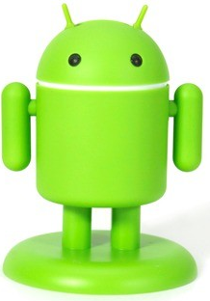
Why android named as “ANDROID”
?
ANDROID
A Robot With A Human Appearance

Slide 3
ANDROID INTRODUCTION
Open source operating system released under the Apache license.
Android is currently developed by the Open Handset Alliance and led by Google.

Slide 4
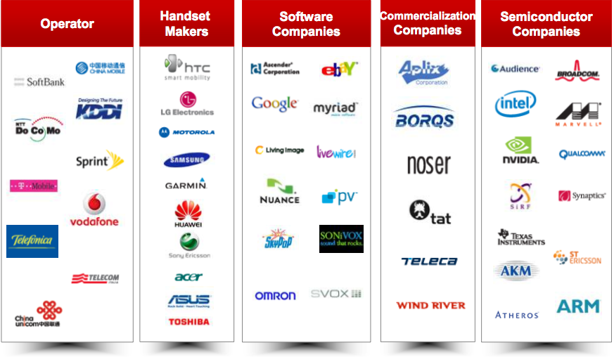
OPEN HANDSET ALLIANCE

Slide 5
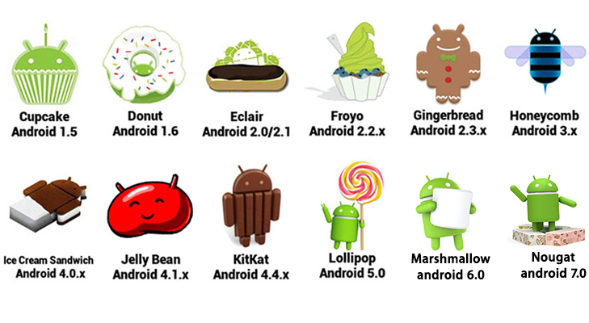
ANDROID VERSIONS

Slide 6
MISSING INITIAL VERSION
???
STARTING WITH
“A”
AND
“B”
???
Alpha
BETA

Slide 7
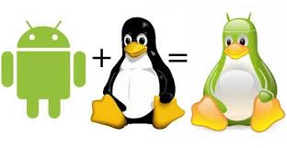
ANDROID INTRODUCTION
Android is Linux based (3.4 or 3.10) OS.
Provides more security
Memory management
Driver management, etc.

Slide 8
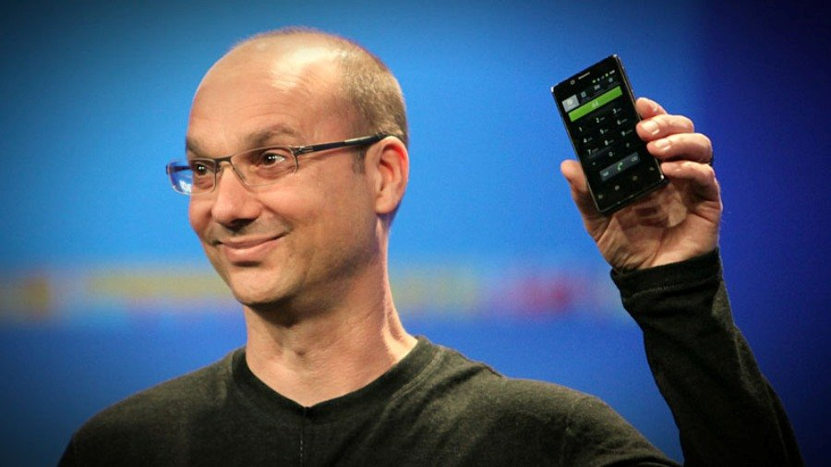
ANDROID HISTORY
Android, Inc. was founded in Palo Alto, California in October 2003 by Andy Rubin and his team.
Andy Rubin

Slide 9
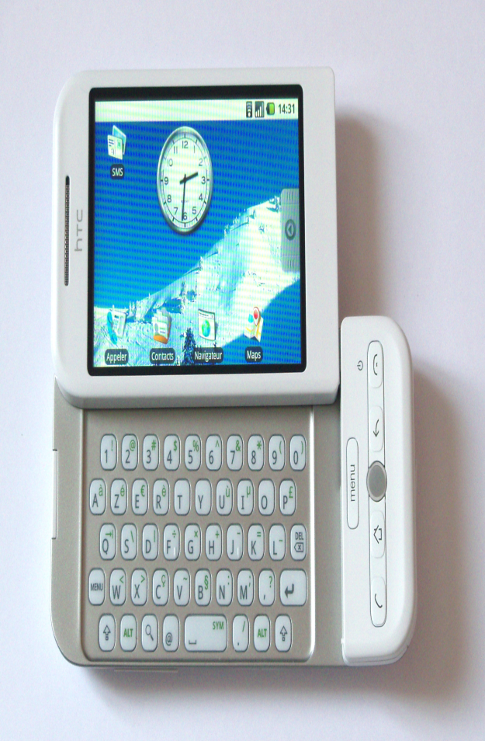
ANDROID HISTORY
In July 2005, Google acquired Android Inc. for at least $50 million.
HTC Dream

Slide 10
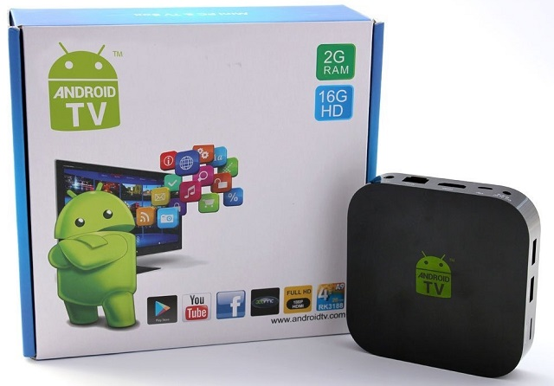
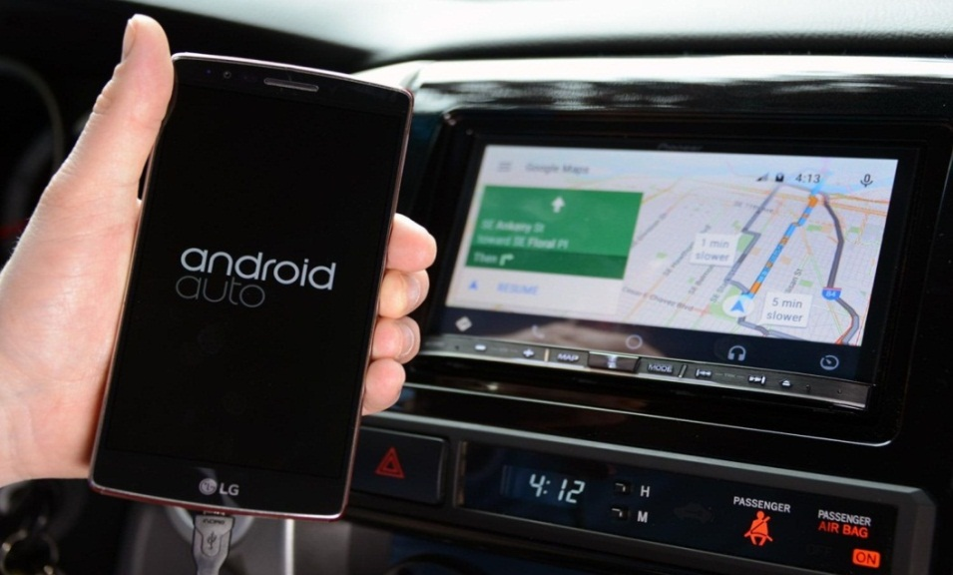
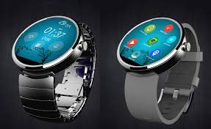
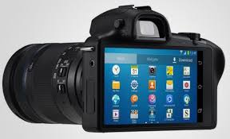
ANDROID FUTURE

Slide 11
ANDROID APPLICATION DEVELOPMENT
Android
SDK
Eclipse IDE
Android
Mobile
Device
Android
Emulator

Slide 12
ANDROID APPLICATION DEVELOPMENT
Android Studio
Android
SDK
Android
Emulator
Android Mobile Device

Slide 13
DOWNLOAD ANDROID STUDIO
Download Android Studio from:
https://developer.android.com/studio/index.html

Slide 14
ANDROID APPLICATION DEVELOPMENT
Java Source Code
Java Compiler
Java Byte Code
DEXER-Tool
Dalvik Byte Code
Java Virtual Machine
DVM

Slide 15
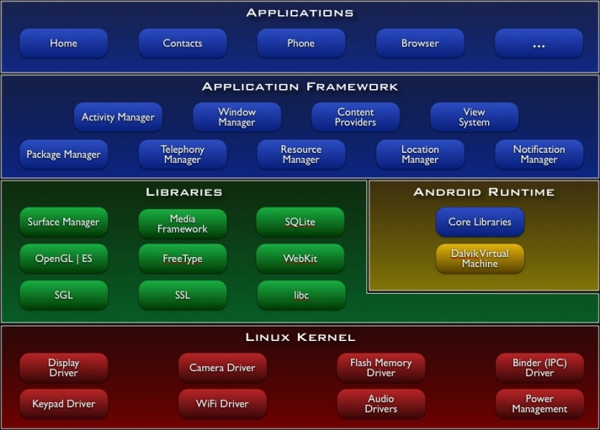
ANDROID ARCHITECTURE

Slide 16
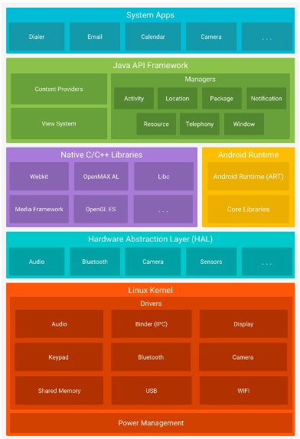

Slide 17


BEFORE NOUGAT (7.0)
BEFORE LOLLIPOP(5.0)
AFTER LOLLIPOP(5.0)
Android app
Android app
Use JIT(Just-In-Time) compilation.
Use AOT(Ahead-Of-Time) compilation.
JIT convert source code into native when app runs.
JIT reduces the installation time but user suffer with runtime performance.
AOT convert source code into native when app installs.
AOT increases the app runtime performance but deal with the installation time of app.

Slide 18
WITH NOUGAT (7.0)
Android app
No compilation at installation
Bring Profile-guided JIT/AOT Compilation.
ART maintains a profile of each app's hot methods and can precompile and cache those methods for best performance.
It does pre-compilation only when then the device is idle and charging.

Slide 19
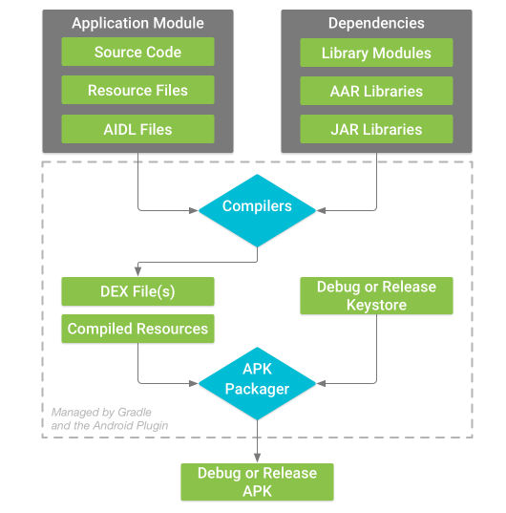
ANDROID PACKAGE BUILD PROCESS

Slide 20
ACTIVITY LIFECYCLE
Primarily includes these states:
Active
Pause
Stop
Destroy

Slide 21
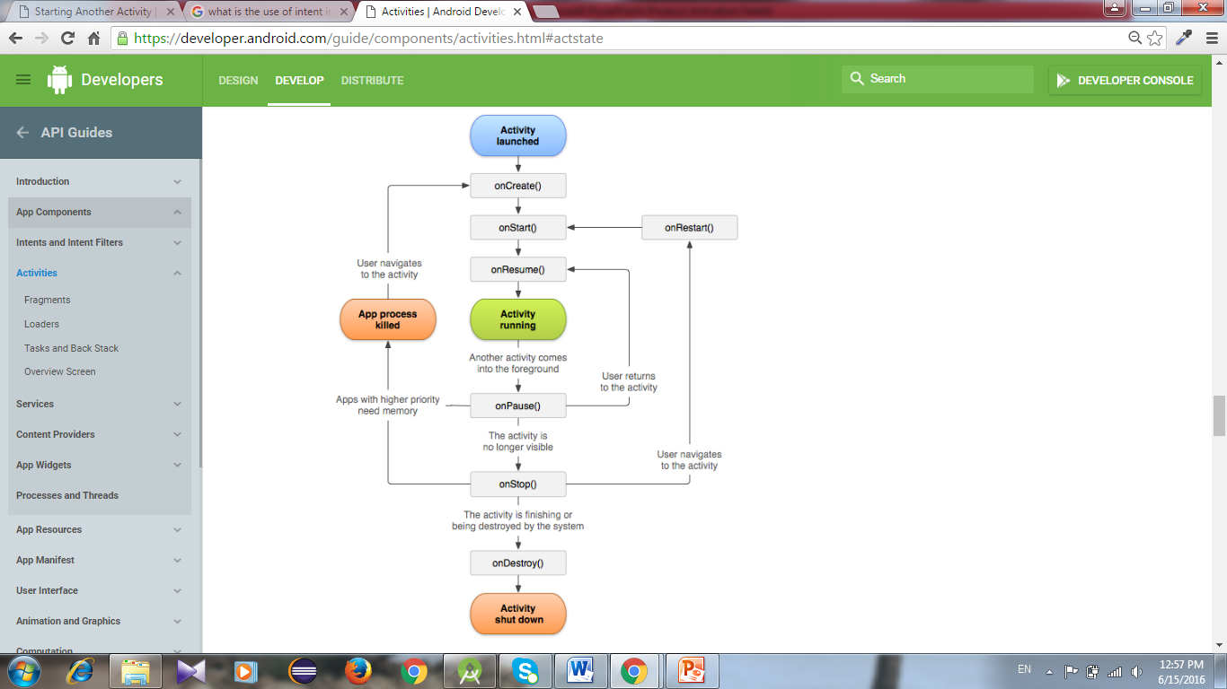

Slide 22
FRAGMENTS
Android introduced fragments in Android 3.0 (API level 11), primarily to support more dynamic and flexible UI designs on large screens, such as tablets.

Slide 23
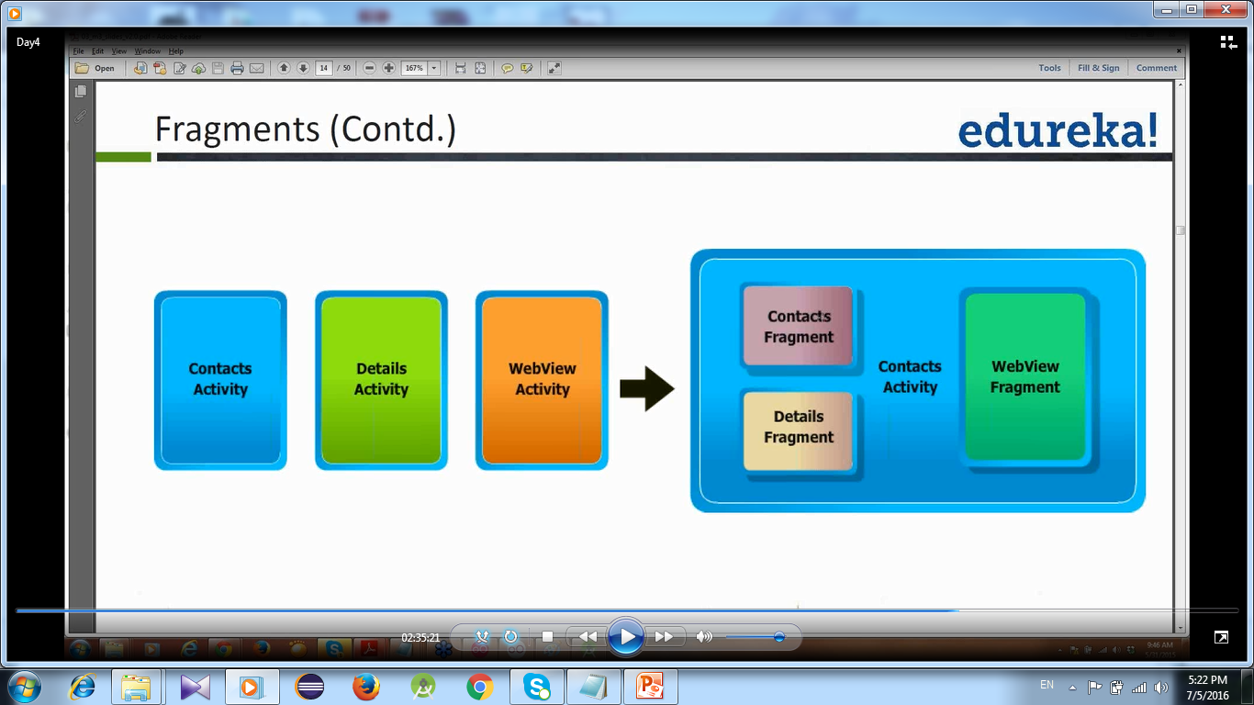
ACTIVITY APPROACH
VS
FRAGMENTS APPROACH

Slide 24
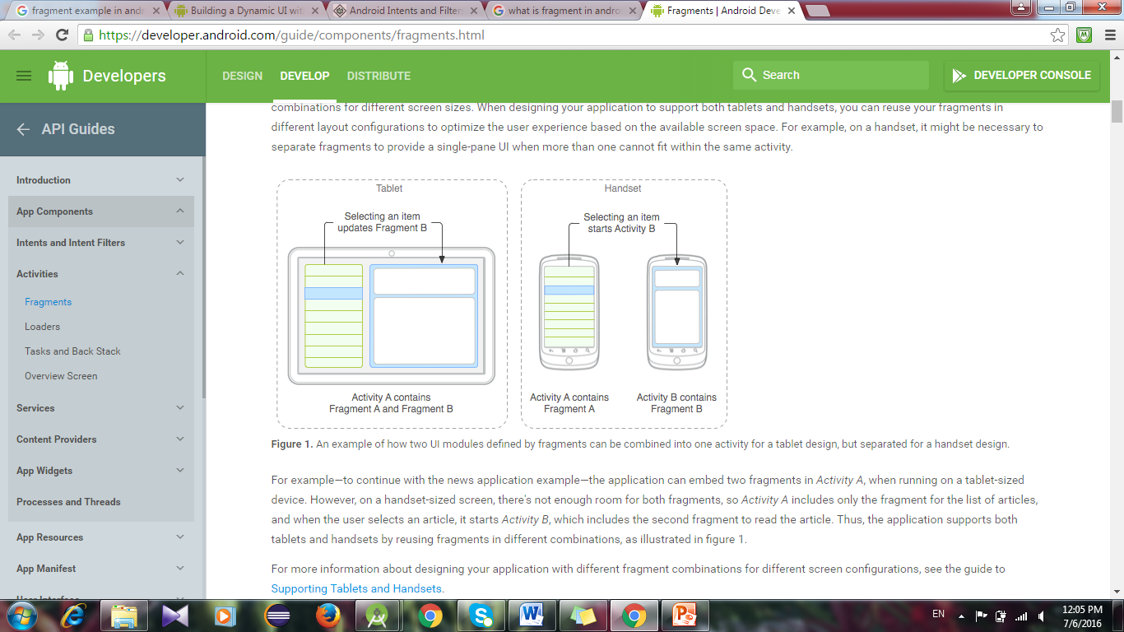
FRAGMENTS
By dividing the layout of an activity into fragments, modification of the activity's appearance at runtime becomes easy.

Slide 25
Animations
Tween animations
Frame animations

Slide 26
Alpha animation
Attributes:
android:fromAlpha : takes a Float value. Starting opacity offset, where 0.0 is transparent and 1.0 is opaque.
android:toAlpha : takes a Float value. Ending opacity offset, where 0.0 is transparent and 1.0 is opaque.

Slide 27
Scale animation
android:fromXScale: Starting X size offset, where 1.0 is no change.
android:toXScale: Ending X size offset, where 1.0 is no change.
android:fromYScale: Starting Y size offset, where 1.0 is no change.
android:toYScale: Ending Y size offset, where 1.0 is no change.
android:pivotX: The X coordinate to remain fixed when the object is scaled.
android:pivotY: The Y coordinate to remain fixed when the object is scaled.

Slide 28
Translate Animation
android:fromXDelta: takes a Float or percentage. Starting X offset.
Expressed either: in pixels relative to the normal position (such as "5"), in percentage relative to the element width (such as "5%"), or in percentage relative to the parent width (such as "5%p").
android:toXDelta: takes a Float or percentage. Ending X offset.
Expressed either: in pixels relative to the normal position (such as "5"), in percentage relative to the element width (such as "5%"), or in percentage relative to the parent width (such as "5%p").

Slide 29
android:fromYDelta: Float or percentage. Starting Y offset.
Expressed either: in pixels relative to the normal position (such as "5"), in percentage relative to the element height (such as "5%"), or in percentage relative to the parent height (such as "5%p").
android:toYDelta: Float or percentage.
Ending Y offset.
Expressed either: in pixels relative to the normal position (such as "5"), in percentage relative to the element height (such as "5%"), or in percentage relative to the parent height (suchas "5%p").

Slide 30
Rotate Animation
android:fromDegrees: Takes a Float. Starting angular position, in degrees.
android:toDegrees: Ending angular position, in degrees.
android:pivotX: Float or percentage.
The X coordinate of the center of rotation. Expressed either: in pixels relative to the object's left edge (such as "5"), in percentage relative to the object's left edge (such as "5%"), or in percentage relative to the parent container's left edge (such as "5%p").
android:pivotY: Float or percentage.
The Y coordinate of the center of rotation. Expressed either: in pixels relative to the object's top edge (such as "5"), in percentage relative to the object's top edge (such as "5%"), or in percentage relative to the parent container's top edge (such as "5%p").

